Slide 1
IX Eurasian Academic Libraries Conference “Alive to Changes: Engage. Embrace. Ensure”
30 September - 2 October | 2020
Information and Digital Literacy workshops for freshmen students at Westminster International University in Tashkent
Viktoriya Levinskaya
LRC Manager, WIUT
Tashkent, Uzbekistan
victoriya.levinskaya@teamuni.uz
Kamola Ibragimova
Head of LRC
Enhancement Unit, WIUT
Tashkent, Uzbekistan
k.ibragimova@wiut.uz

Slide 2
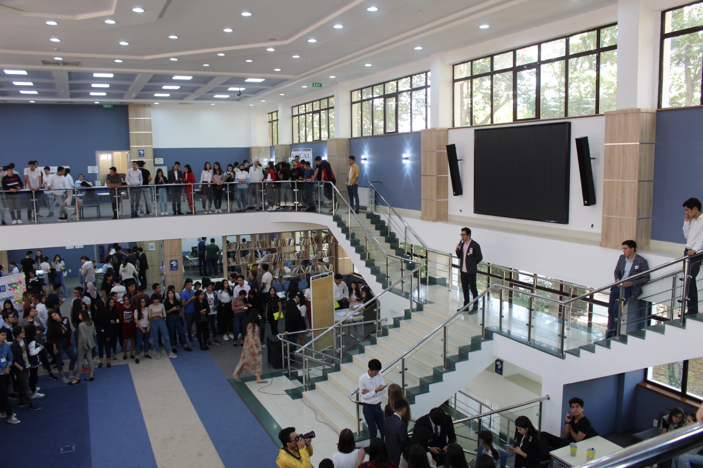
Westminster International University in Tashkent
Learning Resource Center
Founded in 2002
Staff 15
Patrons 4.500
Services resource provision, research
support, IDL training, Reading
Club

Slide 3
Academic Libraries nowadays
Digital
resources
Printed resources
Librarians as information providers
Academic librarians-trainers.

Slide 4
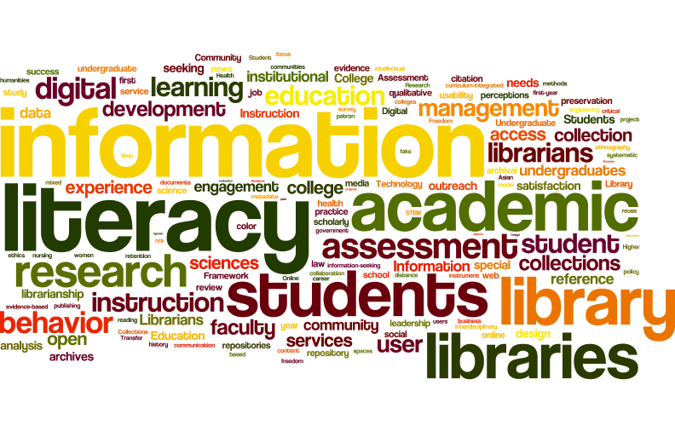
“Information literacy is a set of abilities requiring individuals to recognize when information is needed and have the
ability to locate, evaluate and use
effectively the needed information”
(Association of College and Research Libraries, 2000).

Slide 5
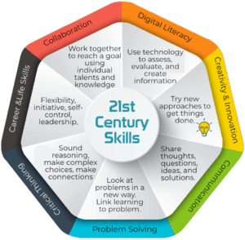
21st Century Skills

Slide 6
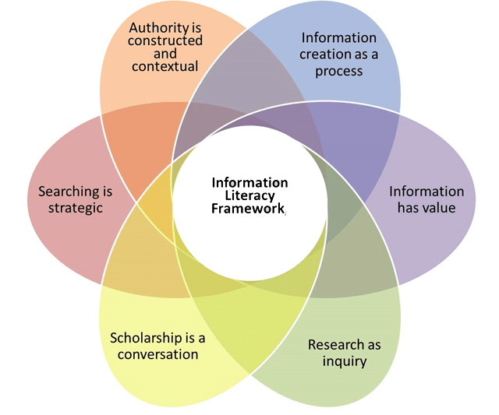
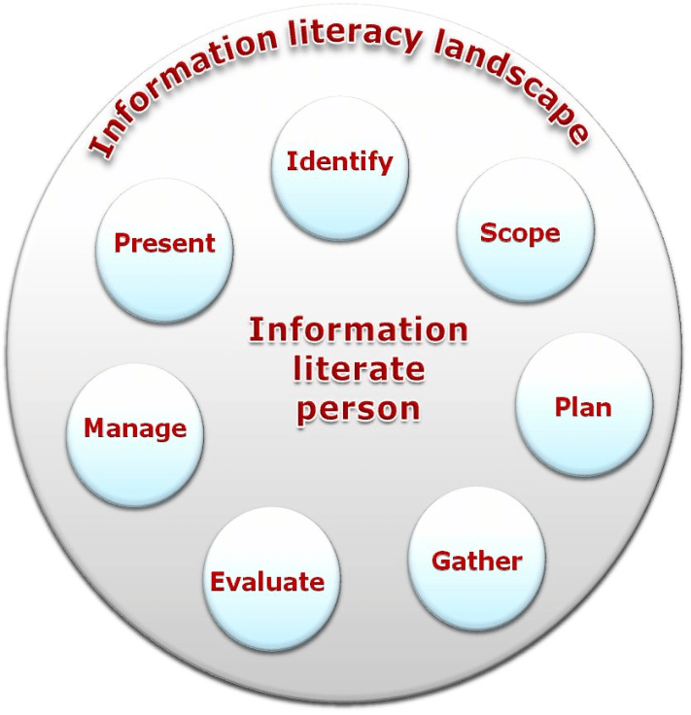
ACRL framework
SCONUL framework

Slide 7
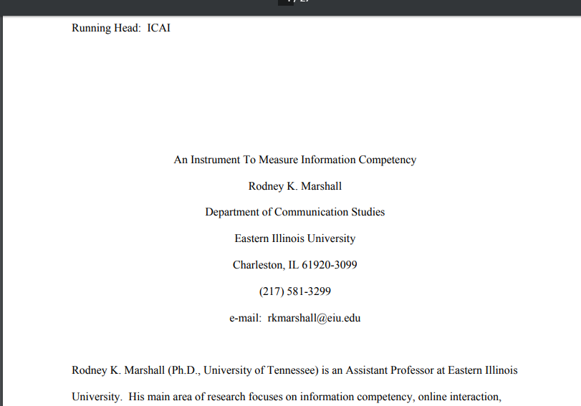

Slide 8
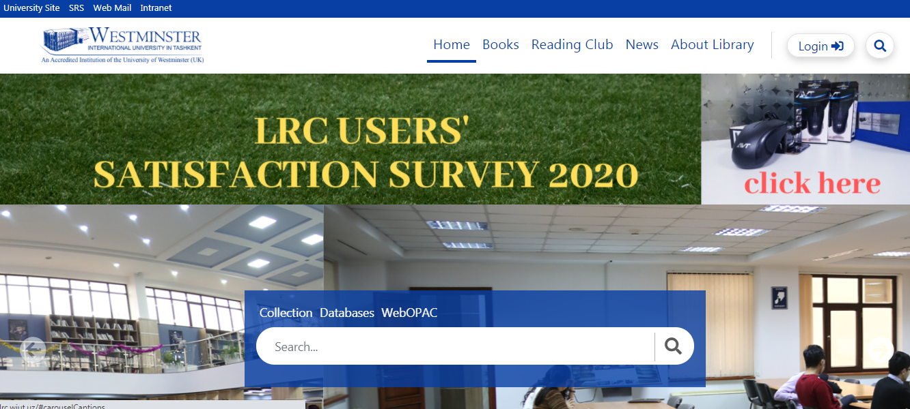

Slide 9
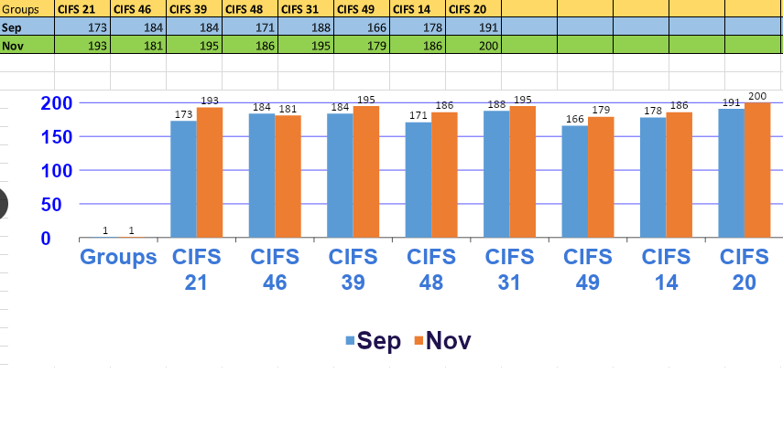

Slide 10
Main findings
98%
92%
appreciated the teaching
experience,
delivery methods
and
interaction of academic librarians
80%
satisfied with the course
5, 3%
enhanced their
information competencies
were not sure about the clarity and usefulness of the content

Slide 12
Images used for the slides
https://www.hamburg.com/academic-libraries/#:~:text=Academic%20Libraries%20Hamburg%20University%20of%20Technology%20Library
http://www.lisbdnet.com/need-of-information-literacy-skills/
https://irdlonline.org/key-words-of-the-2017-irdl-applications/
https://www.lacesmagnetschool.org/apps/pages/index.jsp?uREC_ID=32236&type=d&pREC_ID=165571#:~:text=What%20do%20Teacher%20Librarians%20do?%20Teacher%20Librarians%20specialize%20in%20teaching
https://koolkatscience.net/stem/21st-century-skills/#:~:text=The%20skills%20and%20understandings%20identified%20by%20educators%20and%20businesses%20as
https://www.researchgate.net/figure/The-ACRL-Framework-for-Information-Literacy-and-the-Six-Major-Frames-From-Burress-T_fig6_320992321
https://www.researchgate.net/figure/SCONUL-Seven-Pillars-of-Information-Literacy-2011_fig1_274992567#:~:text=SCONUL%20Seven%20Pillars%20of%20Information%20Literacy%20(2011)
https://www.pinterest.com/pin/434949276495951408/

Slide 13
IX Eurasian Academic Libraries Conference “Alive to Changes: Engage. Embrace. Ensure”
30 September - 2 October | 2020
THANK YOU FOR LISTENING!
Viktoriya Levinskaya
Deputy Rector, TEAM university
Tashkent, Uzbekistan
victoriya.levinskaya@teamuni.uz
Kamola Ibragimova
Head of LRC Enhancement Unit,
Westminster International
University in Tashkent
Tashkent, Uzbekistan
k.ibragimova@wiut.uz

